Slide 1


Data Science Project P-302
Title: Creating Clusters on Global Development Measurement
Group 2: Dr. Renu Maan, Mr. Ritik Sunil Parate, Mr. Kudipud Sai Shiva, Mr. Madiga Poorna Chandra
Mentors: Mr. Varun Vennelaganti and Ms. K.S. Siri

Slide 2
Business Objective:
Business Objective: Creating clusters on global development measurement dataset
Data Set Details: The dataset is having information about important economic and development metrics related to various countries across the globe.
Acceptance Criterion: Work on different clustering models, do a comparative analysis and need to deploy the clustering application on streamlit, flask etc.

Slide 3
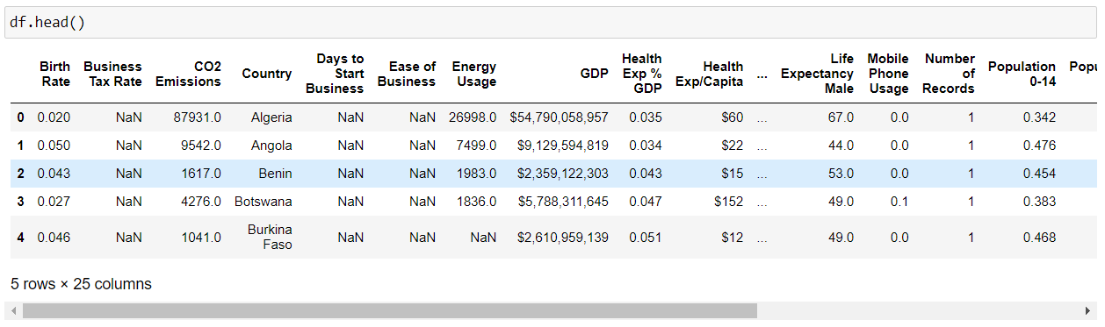
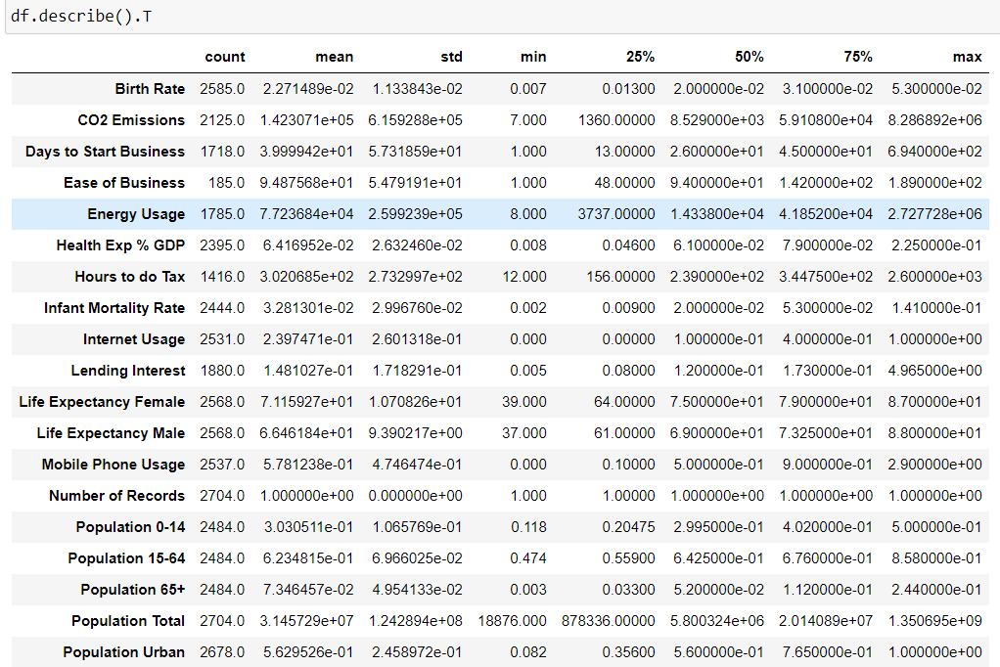
DataSet Details:
This is a sample of the given DataSet. We have around 25 columns and 2700 entries. We have data like Birth Rate, CO2 Emissions, Energy Usage, GDP, Life Expectency, Tourism Inbound, Outbound, etc.
Description of Data: We have basic description of data including
Mean, Median, Standard Deviation,etc. We also get the min and
Maximum values of the particular column in the Dataset.
This description solves most of the questions in our mind about
the DataSet.

Slide 4
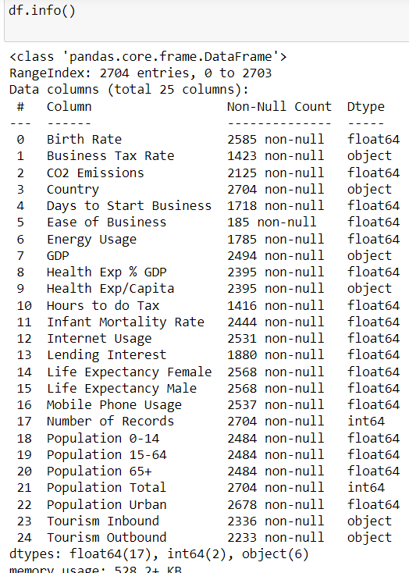
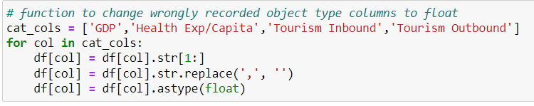
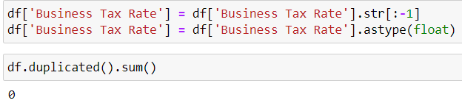
Exploratory Data Analysis(EDA)
Analyzing the Dataset we found there are some columns which does not have
Proper Data Type. So, we have to manually change the datatype of those columns in order to get the proper output in the Model.
We do not have any duplicated values therefore, we can move forward with other steps.

Slide 5
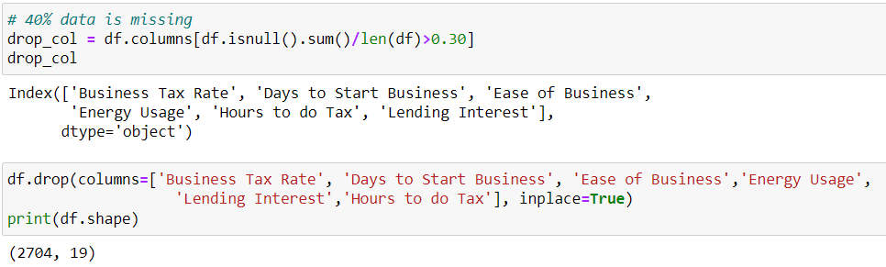
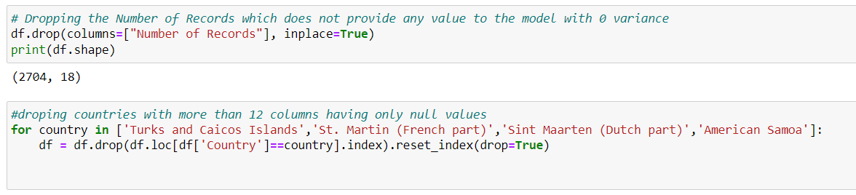
Exploratory Data Analysis(EDA)
Checking for the null values with more than 30% of Null values, we have to drop those columns as they might affect the final model. And finally dropping those columns.

Slide 6
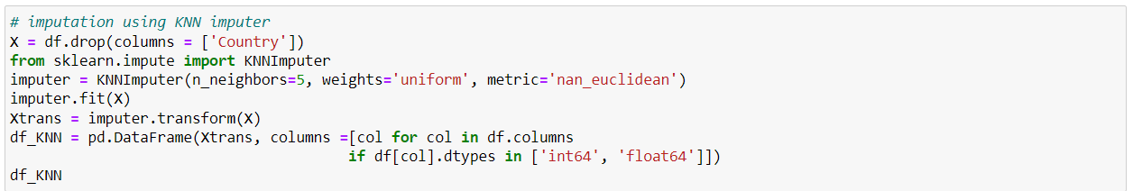
Exploratory Data Analysis(EDA)
Handling missing values: Imputing the Dataset for better analysis to substitute the values to retain most of the information from the dataset.

Slide 7
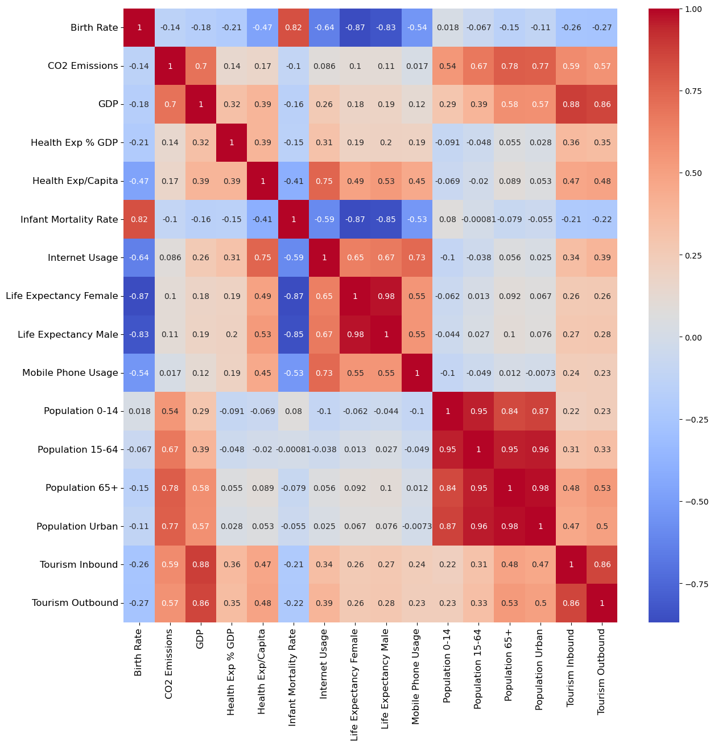
Exploratory Data Analysis(EDA)
Heat Map: To find the correlation among the different columns to get the detailed insights about the relations among the columns.

Slide 8
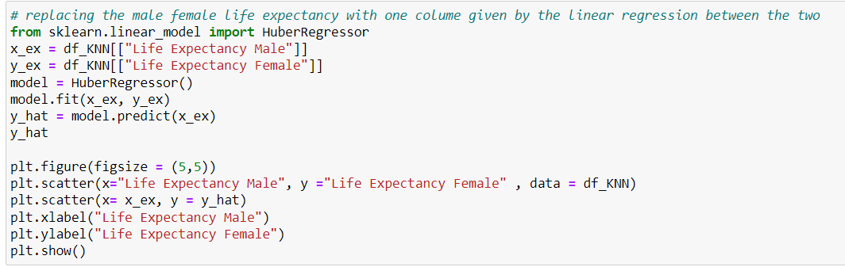
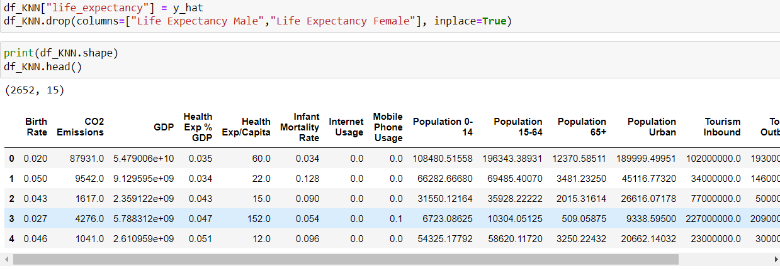
Exploratory Data Analysis(EDA)
Combining the Life Expectancy Male and Female columns for reducing the feature size. We created a single Life Expectancy columns for better analysis

Slide 9
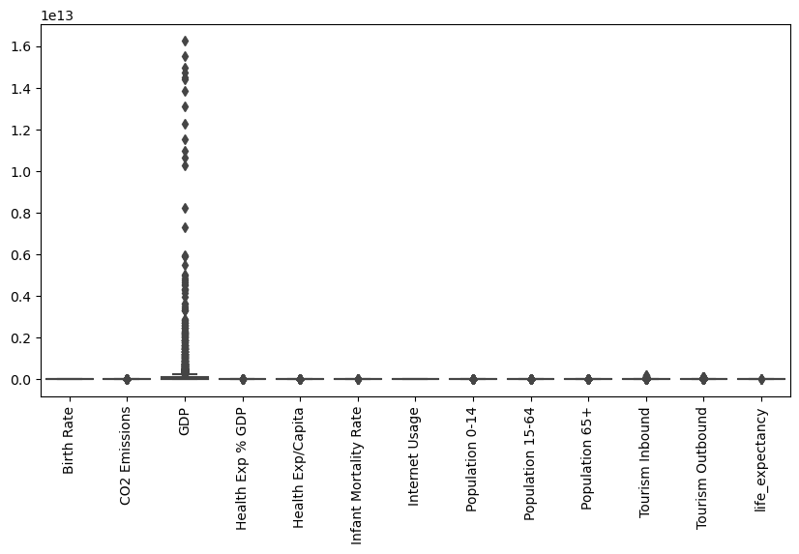
Exploratory Data Analysis(EDA)
Checking the Boxplots for Outlier Analysis. We can Ignore the Outliers as Clustering is also considered as Outlier Detection method. So, the model might help us to detect the outlier in the Dataset.

Slide 10
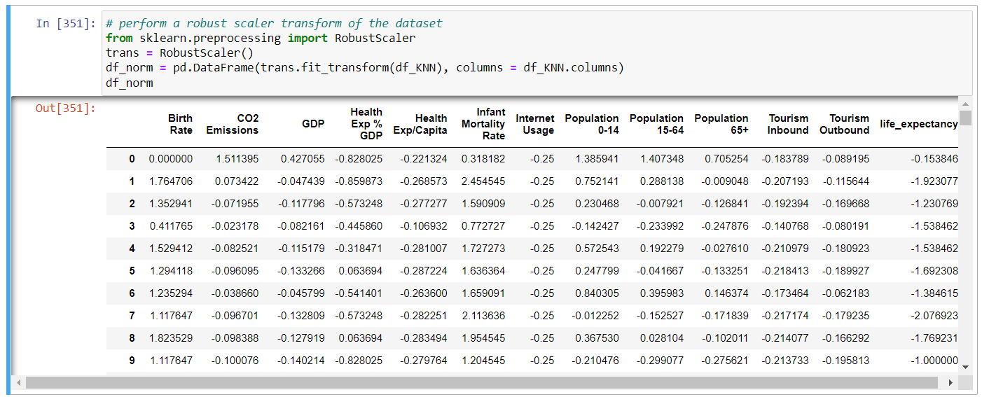
Exploratory Data Analysis(EDA)
Scaling the Dataset using Robust Scaler. Scaling is required as there are distance calculation involved so scaling gives us accurate predictions.

Slide 11
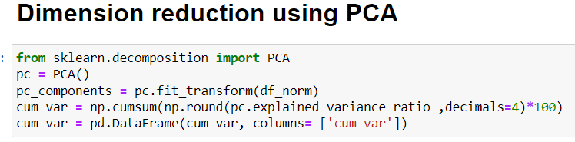
Exploratory Data Analysis(EDA)
Clustering would be extremely difficult or say so Impossible with the number of columns we have. Therefore, we are required to do dimensionality reduction to achieve the min columns. We did PCA for reducing the dimensions to 3.

Slide 12
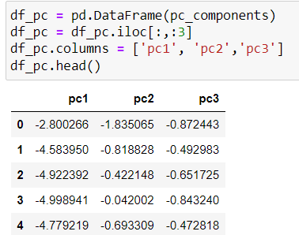
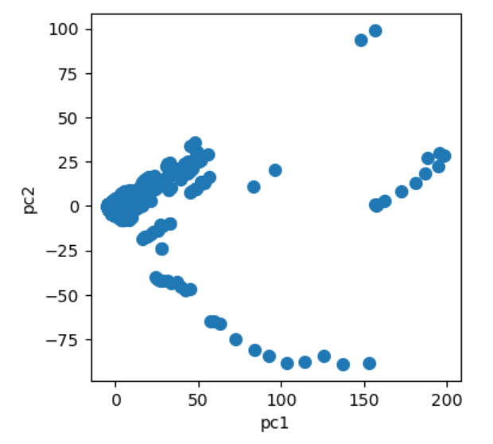
Exploratory Data Analysis(EDA)
PCA results we got a Dataset with 3 features which carries all the Information of the 20 columns of the original Dataset.

Slide 13
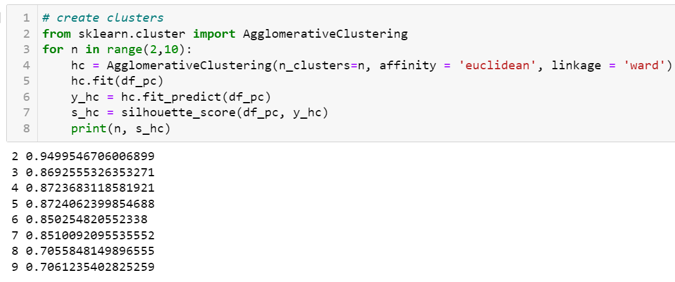
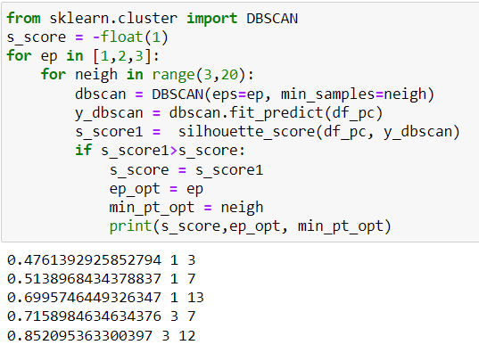
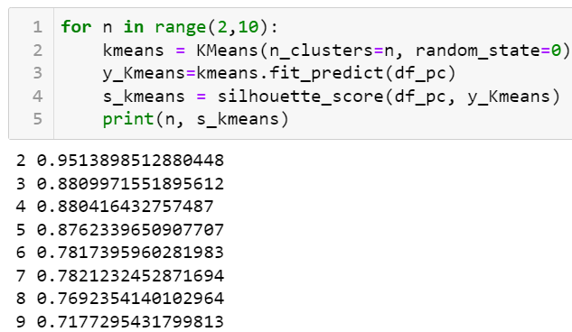
Model Building:
We build models on all the Clustering models including, Agglomerative, DBSCAN, KMeans. Simultaneously we also found the Silhouette score for all the models with all different identified parameters.

Slide 14
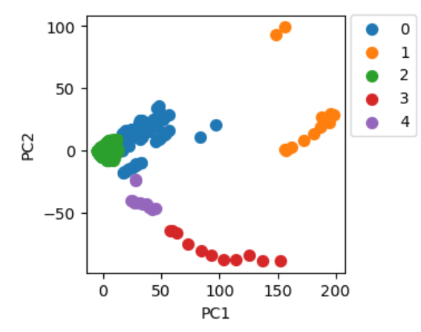
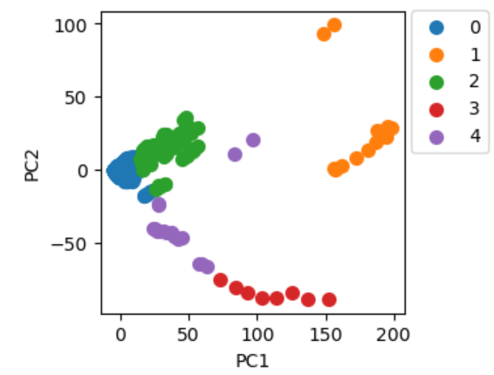
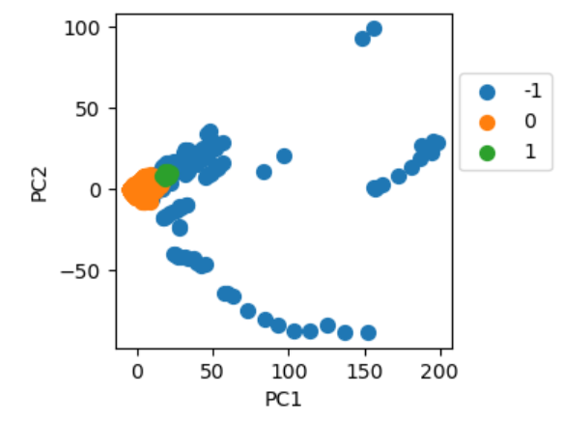
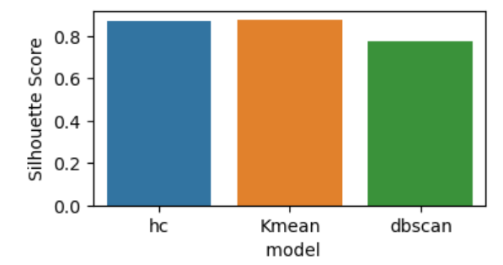
Model Building:
Model Performance (Cluster Plotting) of different models.
Agglomerative Clustering
Kmeans Clustering
DBSCAN Clustering

Slide 15
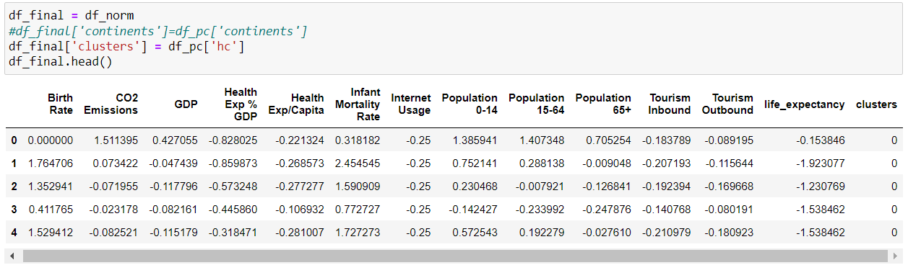
Model Building:
Final Dataset with the cluster information from Agglomerative which has being shortlisted.

Slide 16
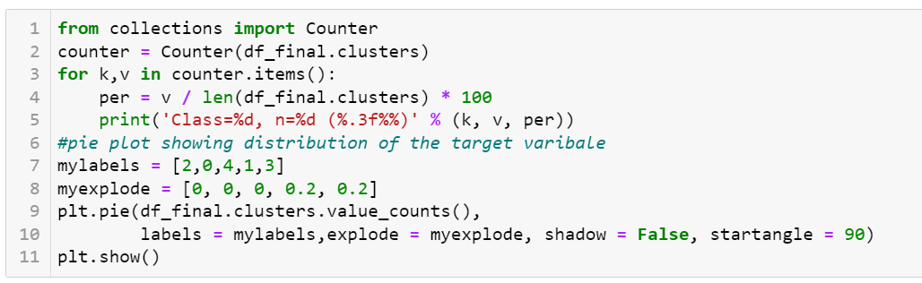
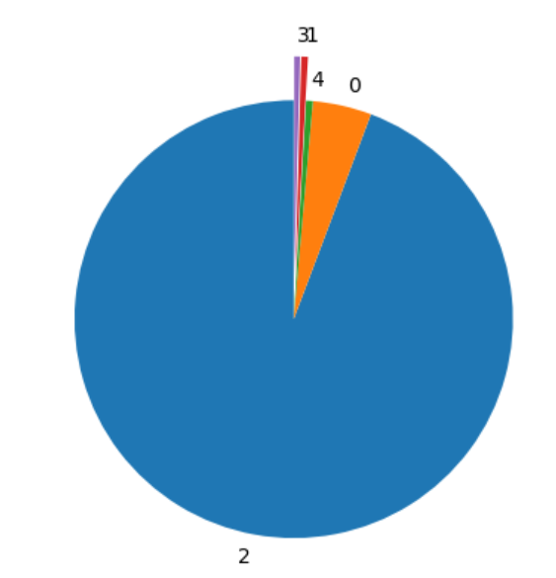
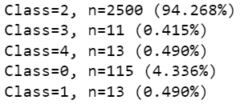
Multiclass classification model Building:
We have classification like, which cluster class has how many datapoints. The Classification is dominated by only one Class which consits 95% of the Data. Therefore, we have to work on it before considering next steps for Classification.

Slide 17
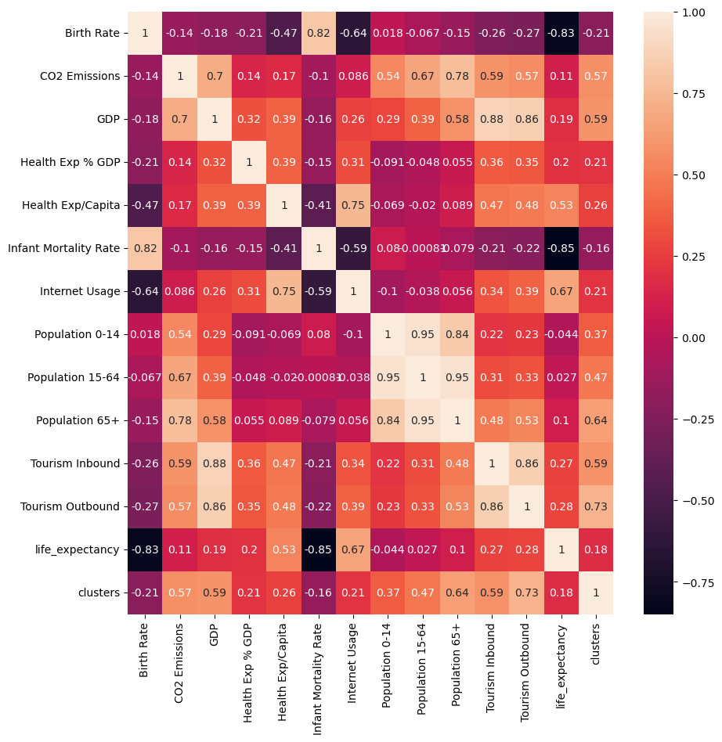
Model Building:
Heat Map: Finding the correlation among the columns for finding better insights of the Dataset.

Slide 18
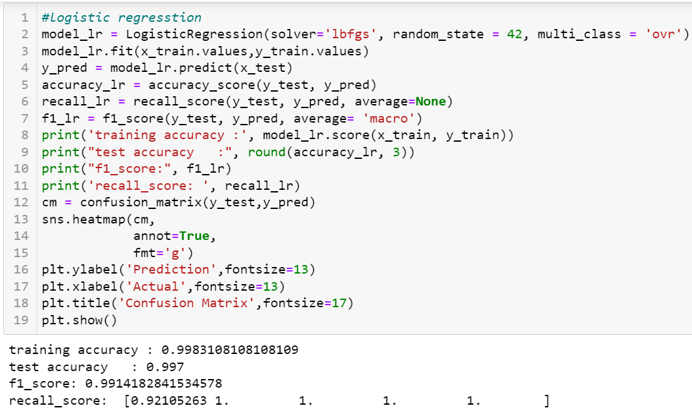
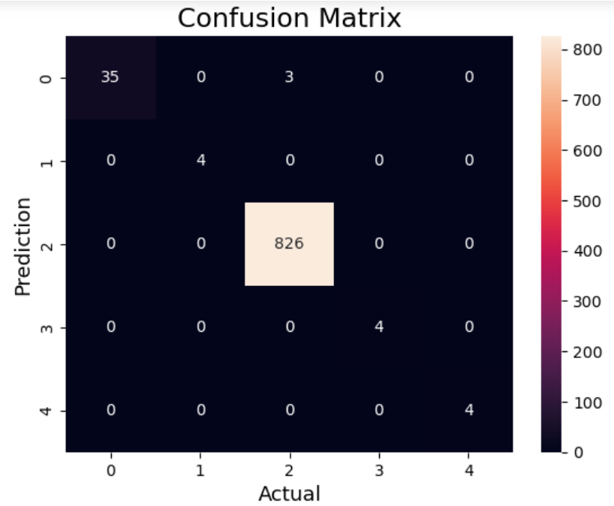
Model Building:
Logistic Regression Model for Classification

Slide 19
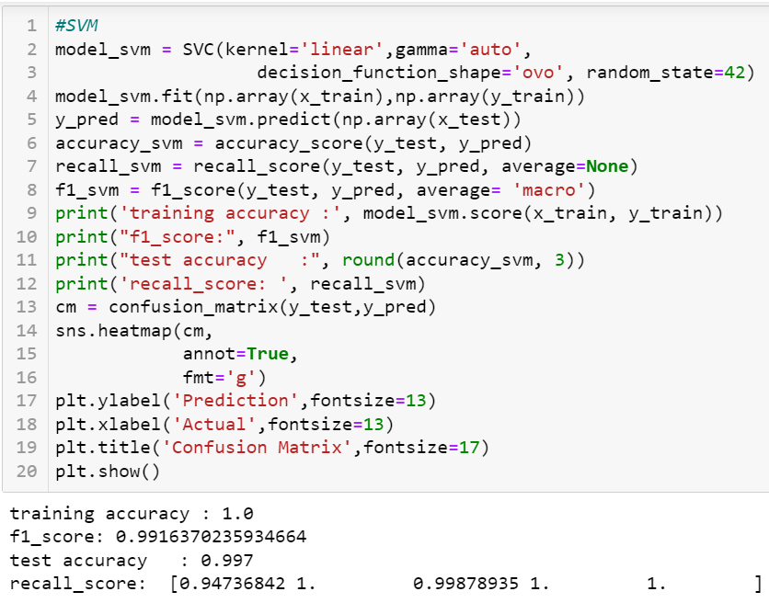
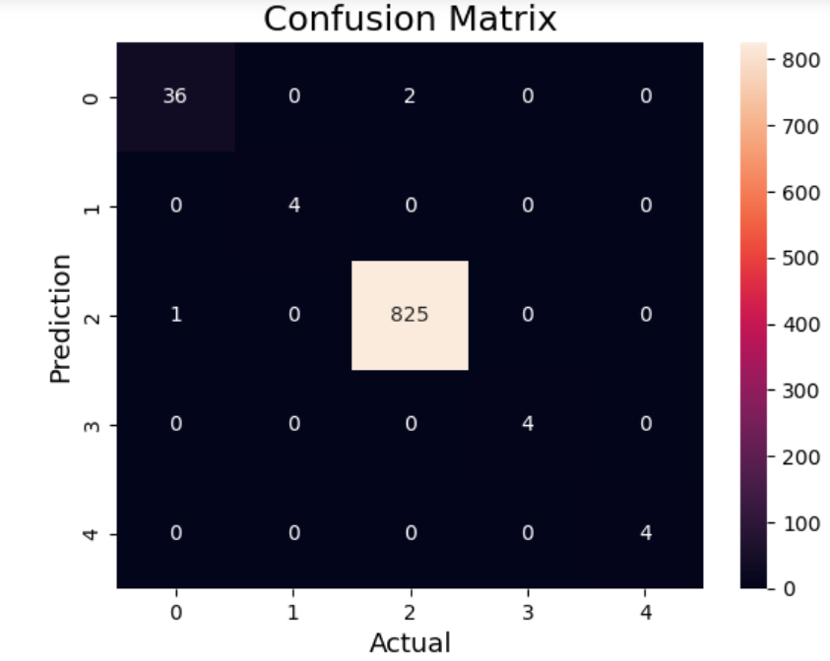
Model Building:
Support Vector Classifier Model for Classification

Slide 20
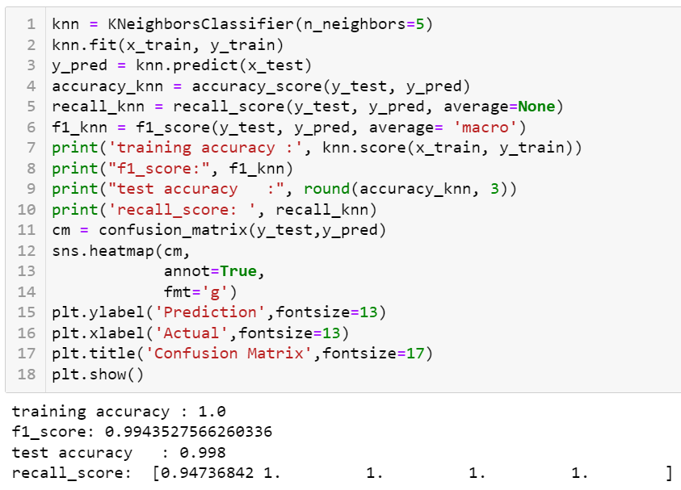
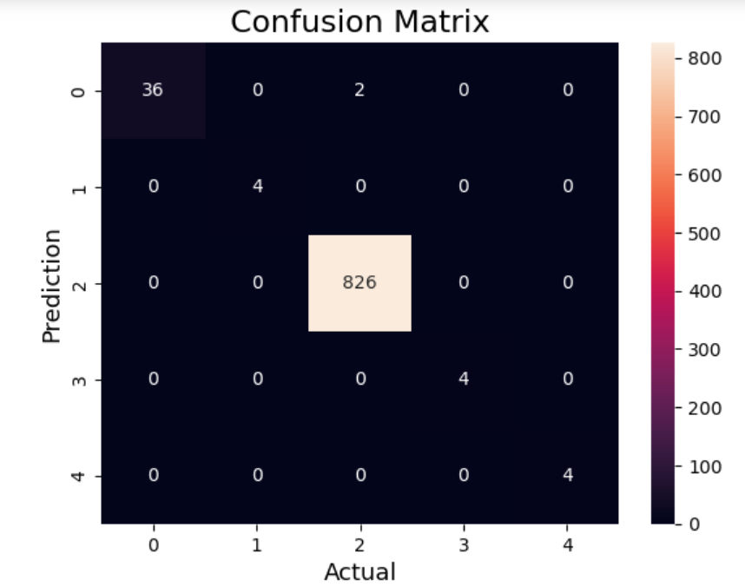
Model Building:
KNN Classifier Model for Classification

Slide 21
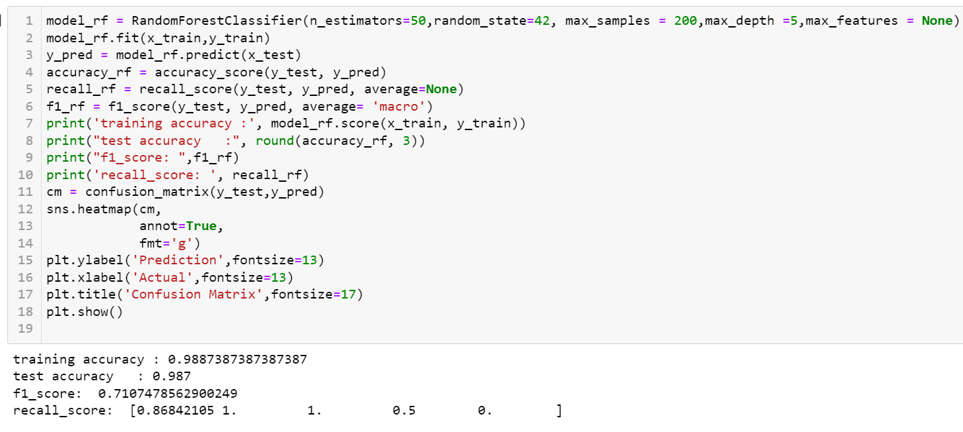
Model Building:
Random Forest Model for Classification Model

Slide 22
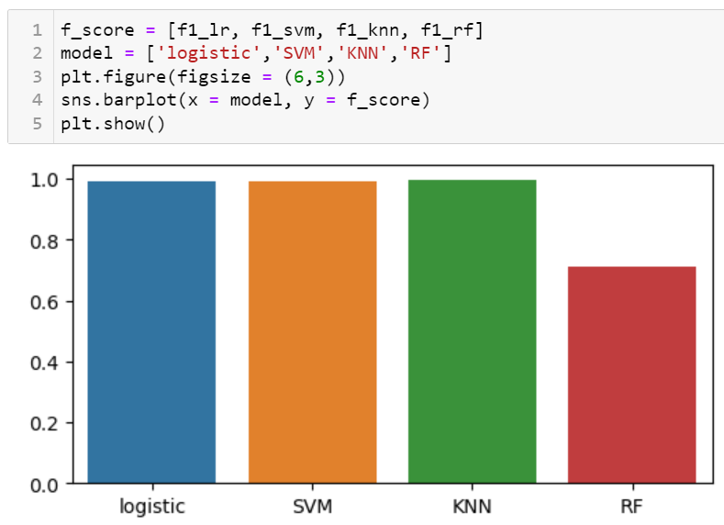
Model Building:
Comparison of all the Classification models in Bar Graph Format.

Slide 23
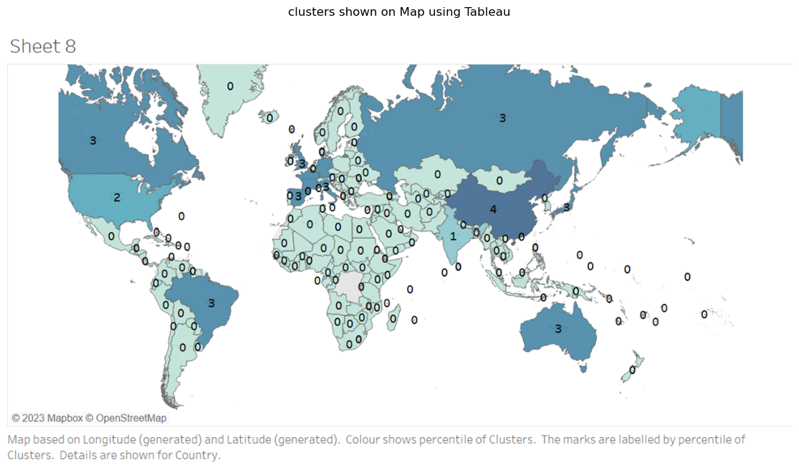
Model Building:

Slide 24
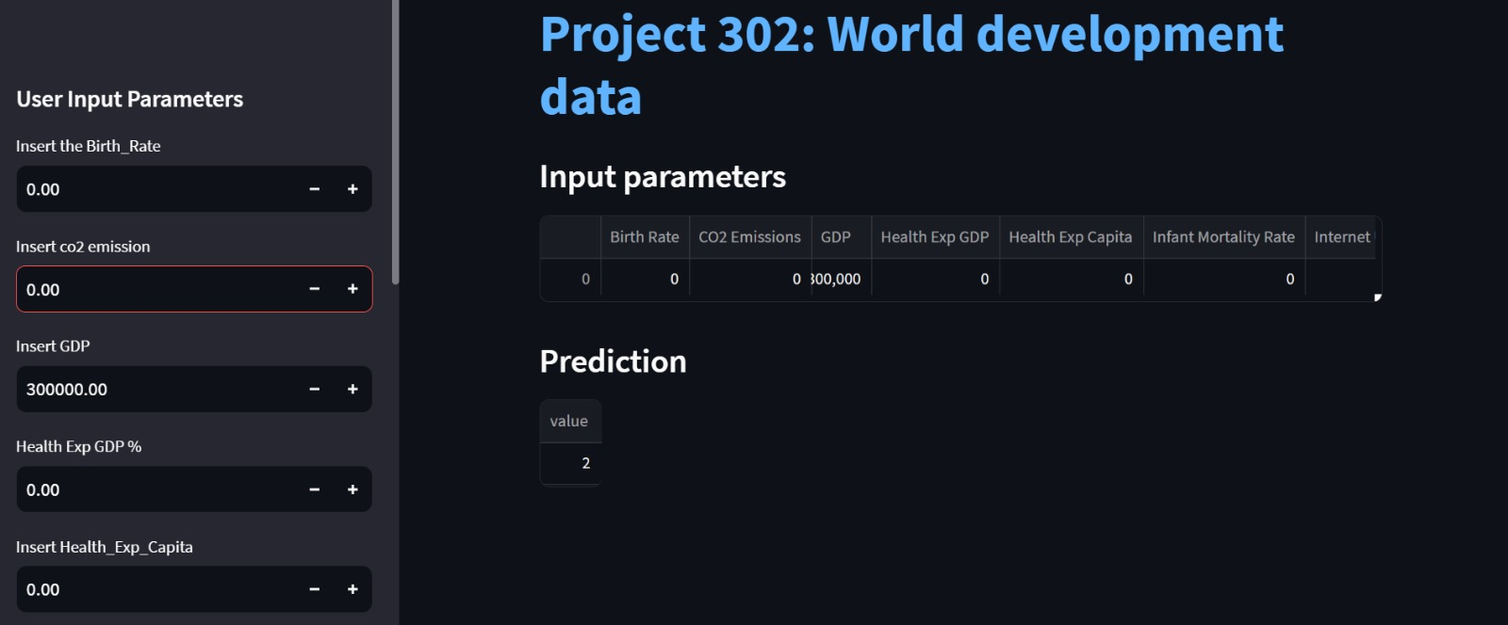
Deployment: Streamlit
Model Deployment UI

Slide 25
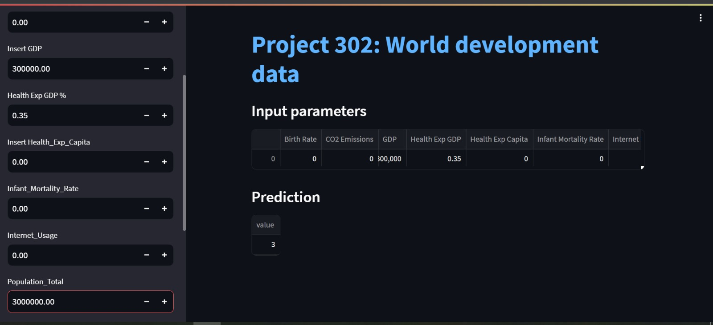
Deployment:Streamlit

Slide 26
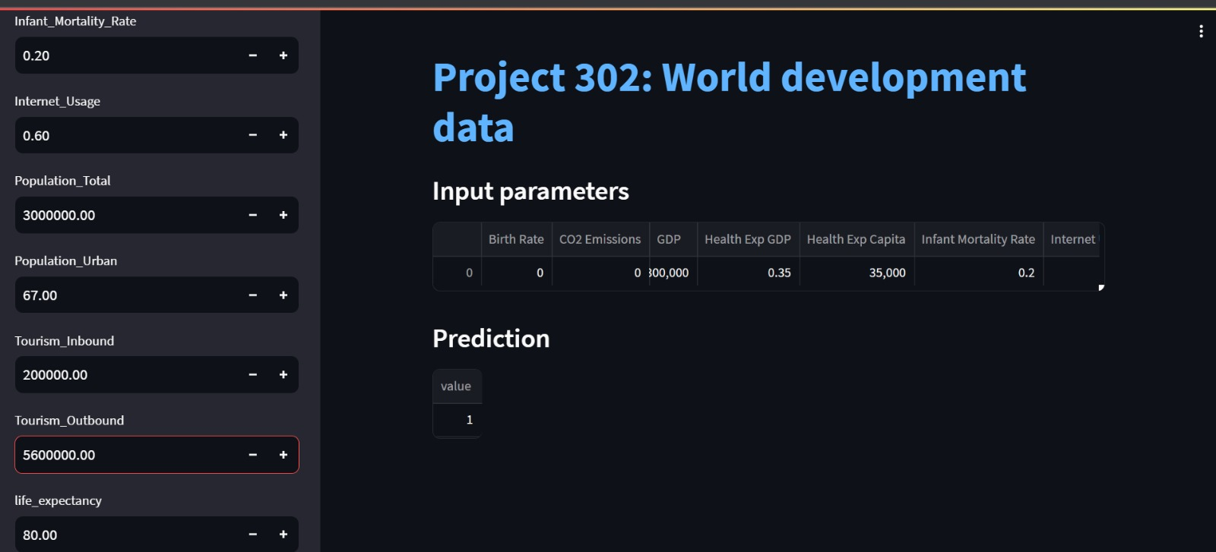
Deployment:Streamlit

Slide 27
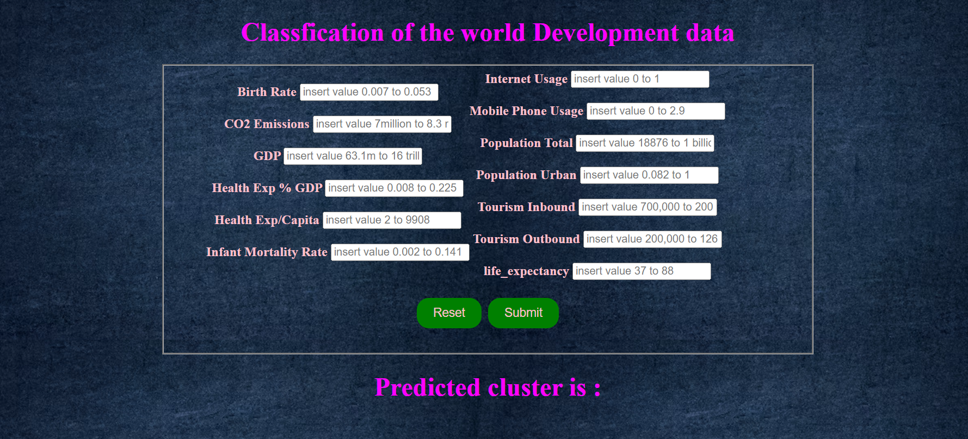
Deployment: Flask

Slide 28
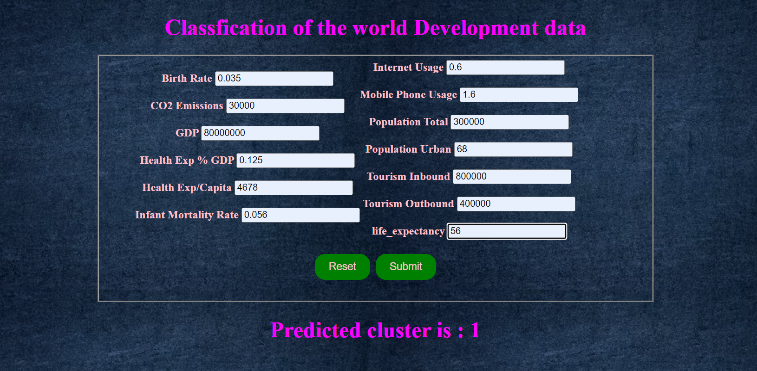
Deployment:Flask

Slide 29
THANK YOU
Any Questions?

